Slide 1

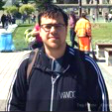
Introduction to Mobile Testing and Device Cloud
Daniel Levy - @dlevy
Director Product Management – Testing & ALM
Robert Shoemate - @shoerob
Software Architect – Mobile Testing

Slide 2
Agenda
Testing / The Quality of Mobile Apps
Challenges
Telerik Mobile Testing
Demos
One More Thing

Slide 3
Testing / The Quality of Mobile Apps

Slide 4
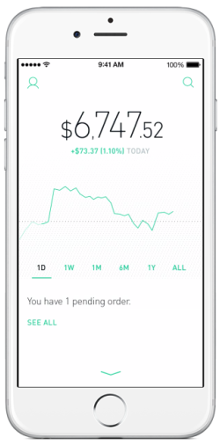








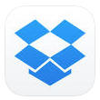


Users have high expectations

Slide 5
But….

Slide 6
Really?

Slide 7
Not meeting those expectations has consequences…

Slide 8
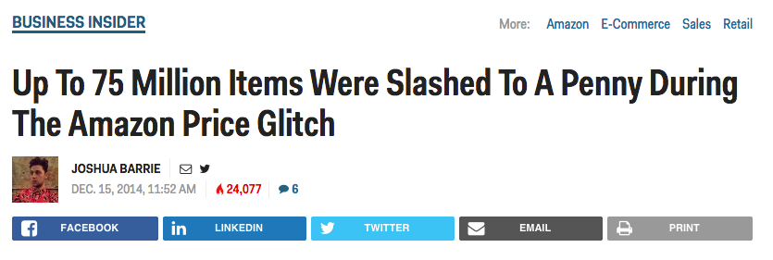
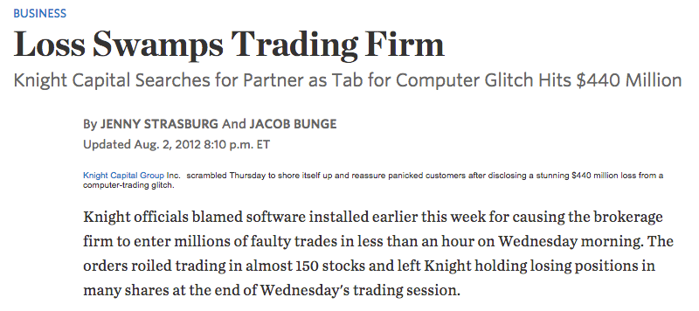
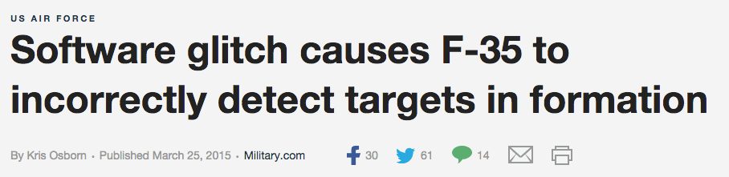
…beyond bad App Store reviews

Slide 9
Challenges in Testing Mobile Apps

Slide 10
Common Challenges in Mobile App Testing
Access to devices (fragmentation)
Time & resource constraints
Availability of mobile testing tools

Slide 11
Fragmentation

Slide 12
World Smartphone OS Market Share (Q4 2014)
Source: IDC - http://www.idc.com/prodserv/smartphone-os-market-share.jsp

Slide 13
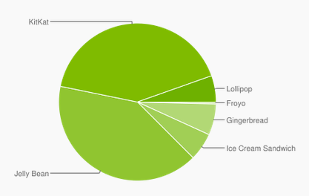
Android Fragmentation
Devices
OS Versions
Source: http://developer.android.com | April 2015
Source: Open Signal - http://opensignal.com/reports/2014/android-fragmentation/

Slide 14
Time & Resource Constraints

Slide 15
Time & Resource Constraints
Manual testing is slow, resource intensive & repetitive

Slide 16
Availability of Tools

Slide 17
Telerik Mobile Testing
Functional UI testing framework
Web developer friendly (JavaScript)
Seamless integration with AppBuilder
Cross-platform testing
Access to real devices in Telerik Device Cloud

Slide 18
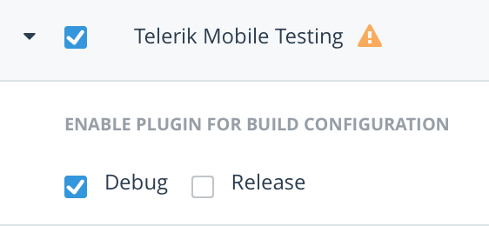
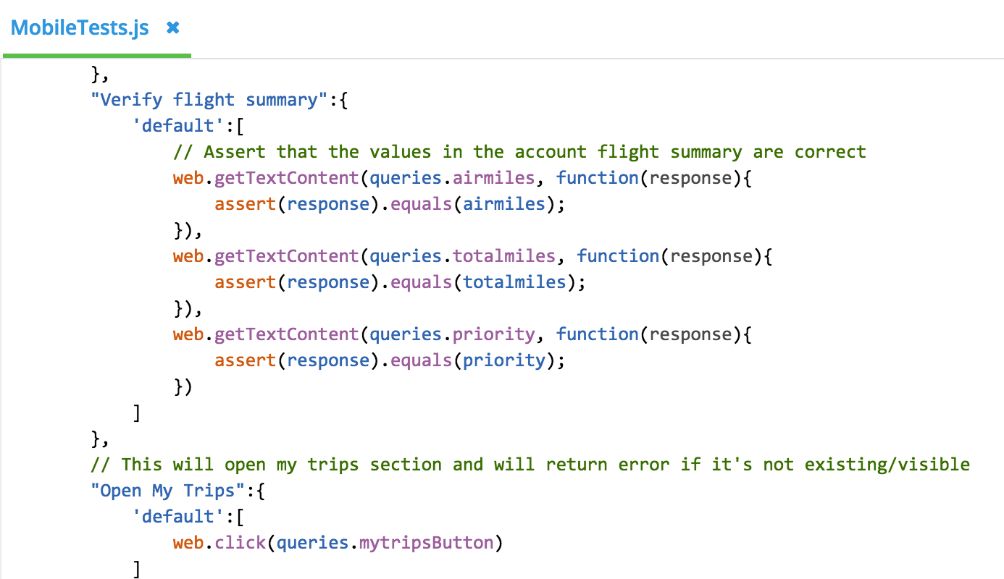


Core Components of Telerik Mobile Testing
App Plug-In
*.js tests
Companion App

Slide 19
Architecture of Mobile Testing
Language Framework
Agent
{ ‘cmd’: ‘tap’, ‘params’: { ‘query’: { ‘index’: 0 } } }
JSON Command
iOS
JavaScript
Relay Server
Android
Etc…
WP8
JSON Result
Web
{ ‘result’: ‘success’, ‘reason’: ‘View successfully tapped.’ }

Slide 20
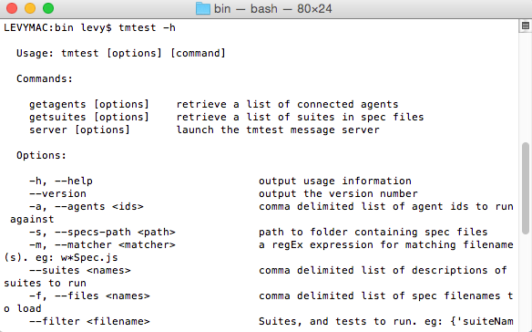
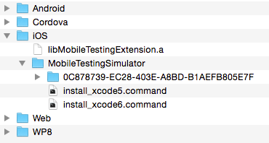
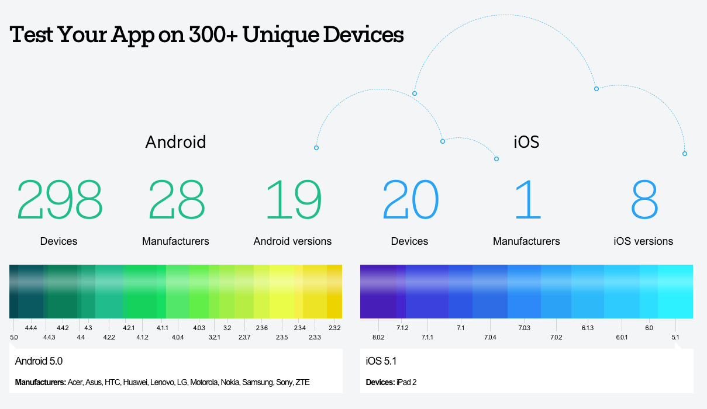
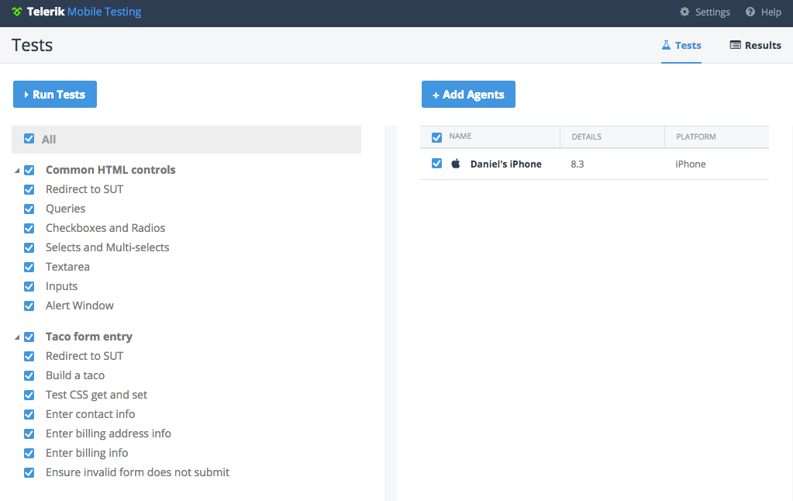
Utilities for Telerik Mobile Testing
Local runners
Plug-in *for non AB apps
Device Cloud *for AB apps

Slide 21
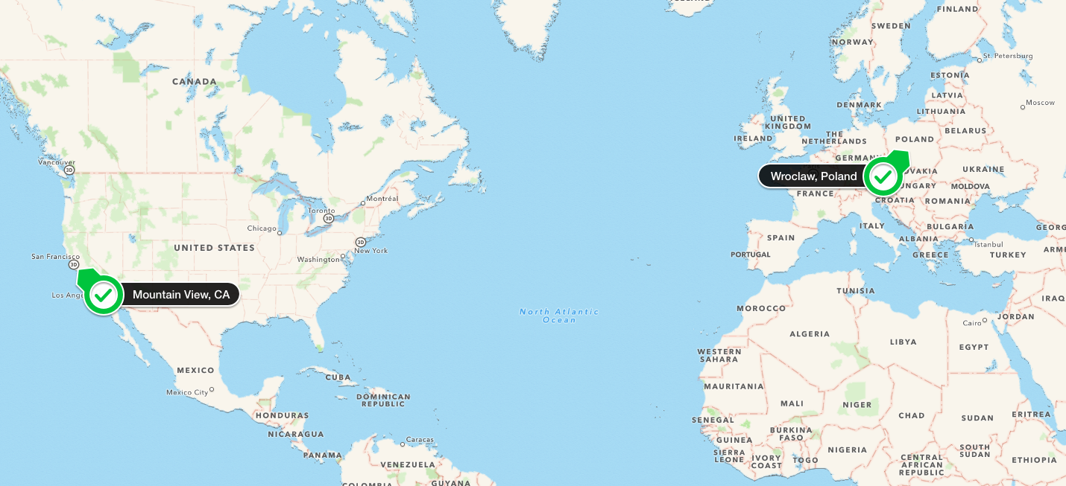
Device Cloud
Device Cloud Data Centers
Mountain View, CA
Wroclaw, Poland
Device Cleanup (after every test run)
All file removed.
Non-system apps are uninstalled.
Devices are re-booted.
Real Devices
Not Rooted or Jail-broken

Slide 22
Demos
Robert Shoemate - @shoerob
Software Architect – Mobile Testing

Slide 23
What’s NEXT?

Slide 24
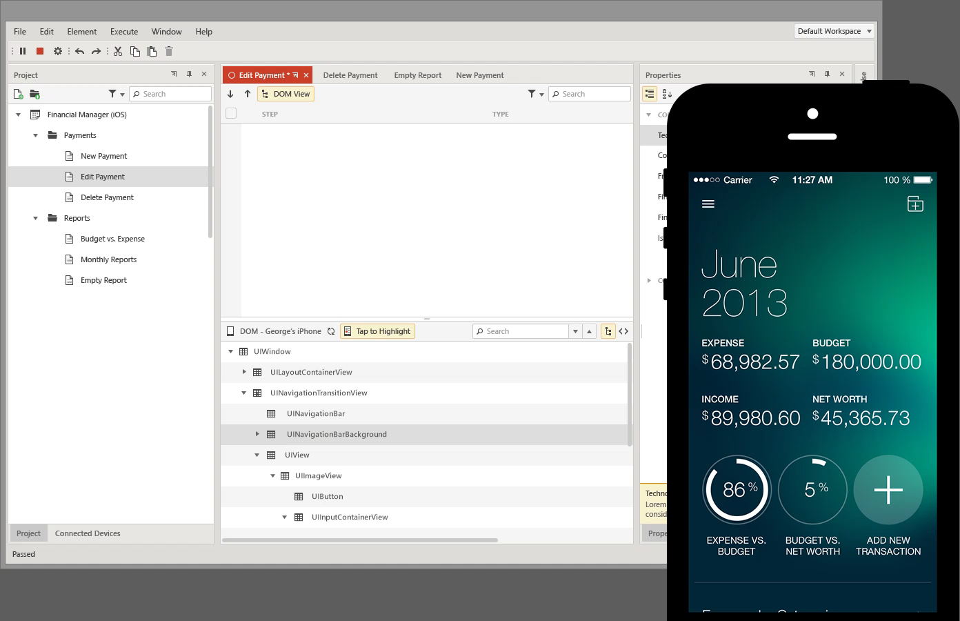

Slide 25
Thank You! Questions?
GitHub Repo: https://github.com/shoerob/TelerikNEXT-MobileTesting
Daniel Levy - @dlevy
Director Product Management – Testing & ALM
Robert Shoemate - @shoerob
Software Architect – Mobile Testing

